Slide 1
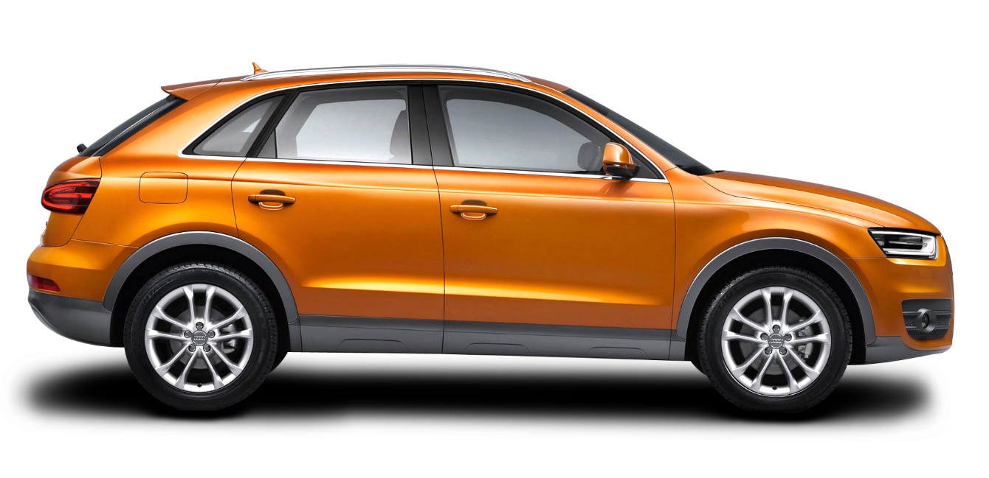
Car dheko - used car price prediction
Analysis – YUVARAJ R

Slide 2
Project Overview
The Car Dheko - Used Car Price Prediction project aims to enhance customer experience and streamline pricing processes within the automotive industry by developing a machine learning model to predict used car prices based on various features. This predictive model will be integrated into an interactive, user-friendly Streamlit application, allowing customers and sales representatives to input car details and obtain an instant price estimate.

Slide 3
Descriptive statistics and key insights
Kilometer Driven = Mean: 58,974 km, Median: 53,692 km, Mode: 120,000 km, Standard Deviation: 74,060 km, Range: 0 to 5,500,000 km
Insight: Most cars have a moderate mileage around 54,000 km, but the high standard deviation and extreme max value suggest possible outliers. Cars with extremely high or low kilometers might need further investigation to ensure data quality.
Owner Number (Owner_No.) = Mean: 1.36 owners, Median: 1 owner, Mode: 1 owner, Standard Deviation: 0.64, Range: 0 to 5 owners
Insight: Most cars have had only one previous owner, making them more attractive to buyers. Higher owner numbers may affect price, indicating the car's history.
Model Year = Mean: 2016.5, Median: 2017, Mode: 2018, Standard Deviation: 3.92, Range: 1985 to 2023
Insight: Most cars in the dataset are relatively recent, with a strong concentration around 2017–2018, which is ideal for identifying modern market trends.

Slide 4
Descriptive statistics and key insights
Price (Normalized) = Mean: 0.0089, Median: 0.000062, Mode: 0.000065, Standard Deviation: 0.0794, Range: 0 to 1
Insight: The price data appears heavily skewed with many lower-value cars, as indicated by the median being close to zero. The wide spread suggests a varied price range across cars, likely due to factors like age, mileage, and condition.
Seat = Mean: 5.2 seats, Median: 5 seats, Mode: 5 seats, Standard Deviation: 0.68, Range: 0 to 10 seats
Insight: Most cars are standard 5-seaters, which aligns with common consumer preferences. A few cars with higher seat counts likely represent larger models (e.g., vans or SUVs).
Engine Displacement = Mean: 1,424 cc, Median: 1,248 cc, Mode: 1,197 cc, Standard Deviation: 478.53, Range: 0 to 5,000 cc
Insight: The majority of cars have engine capacities in the mid-range (1,200–1,500 cc), suitable for everyday use. Extreme values could indicate high-performance or specialty vehicles, which may impact price.

Slide 5
Descriptive statistics and key insights
Mileage = Mean: 18.47 km/l, Median: 18.9 km/l, Mode: 0 km/l, Standard Deviation: 5.38, Range: 0 to ~50 km/l
Insight: A median mileage of around 18.9 km/l suggests fuel efficiency is a common trait, which is appealing to cost-conscious buyers. The zero values may represent missing data or data entry errors.
Max Power and Torque = Max Power (Mean): 102.17 hp, Median: 88.5 hp, Torque (Mean): 161 Nm, Median: 115 Nm
Insight: The average max power and torque values align with mid-range, fuel-efficient engines. Cars with higher power and torque values may target performance-oriented customers.

Slide 6
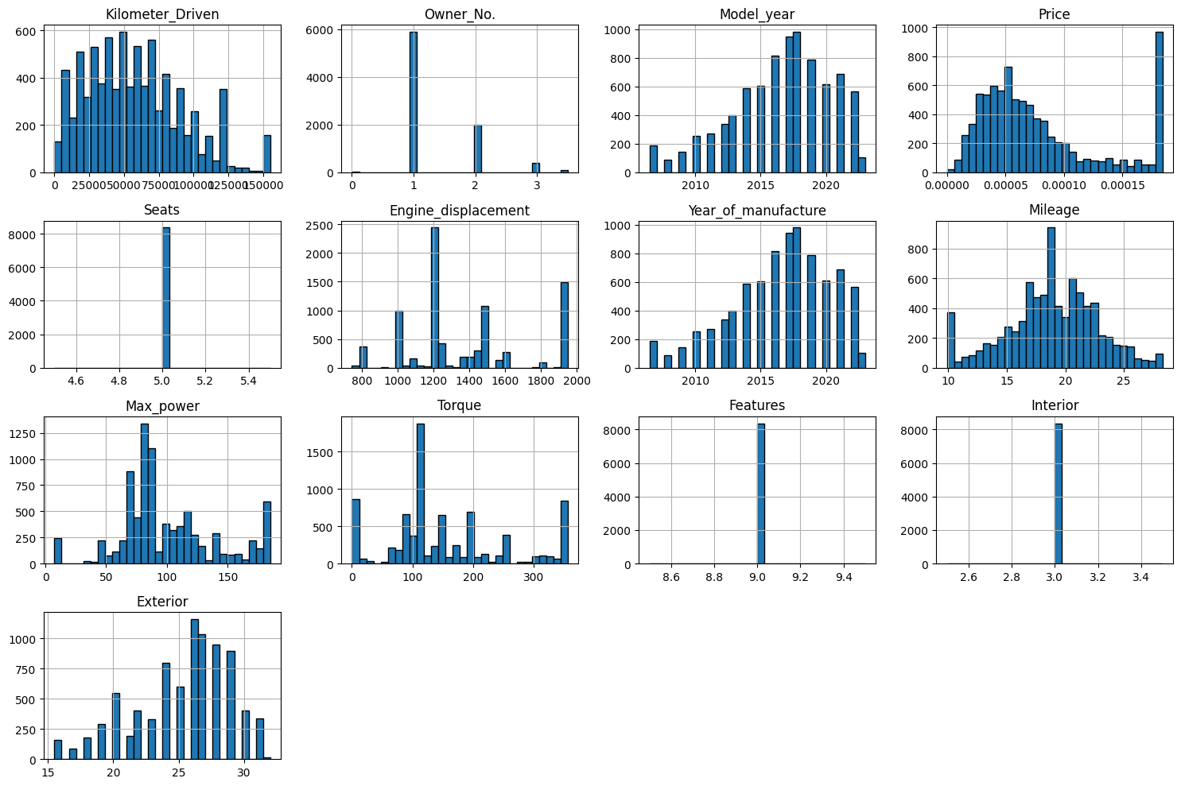
histograms
Summary: The dataset seems to consist primarily of relatively newer vehicles with standard features, mostly first-owner cars. Key variables like Price, Kilometer Driven, and Engine Displacement show significant variation, which could be useful in predictive modeling (e.g., price prediction).

Slide 7
histogram in our visualization
Kilometer Driven: The distribution shows that most cars have mileage below 75,000 km, with a significant decline in frequency as the distance increases.
Owner No: The data shows a high frequency for cars owned by a single owner, with fewer cars owned by two or more owners, indicating that most cars are likely first-hand.
Model year: The distribution is skewed towards newer model years, with a peak around 2015-2020, indicating that more recent cars are prevalent in the dataset.
Price: The distribution for price is heavily right-skewed, with most cars clustered at lower price points and only a few high-priced outliers.
Seats: This distribution is almost a single point, suggesting most cars have the same number of seats, likely a standard count, which could indicate that the dataset mostly includes similar types of cars.
Engine displacement: There is a peak around 1200-1500 cc, with another smaller peak at 2000 cc, which might represent different classes of vehicles (e.g., compact vs. SUVs).
Year of manufacture: Similar to the Model year distribution, this is skewed towards recent years, with a noticeable peak between 2015 and 2020.

Slide 8
histogram in our visualization
Mileage: The distribution shows a central peak around 20, suggesting that most cars have an average mileage in this range, likely measured in km/liter.
Max power: The data shows several peaks, suggesting a range of power ratings, with a concentration around 75-150, likely indicating different categories or classes of cars.
Torque: The distribution is widely spread, with peaks at specific values, indicating a varied range in torque levels for the vehicles in the dataset.
Features: The data points here are concentrated at a specific value, suggesting that most cars have a similar rating or score for features, or it could be a binary/limited scale.
Interior: Like "Features," this is concentrated at one value, possibly indicating a standard score or assessment level for interior features across most vehicles.
Exterior: This has a more spread-out distribution, indicating some variety in the exterior features or conditions of the vehicles.

Slide 9
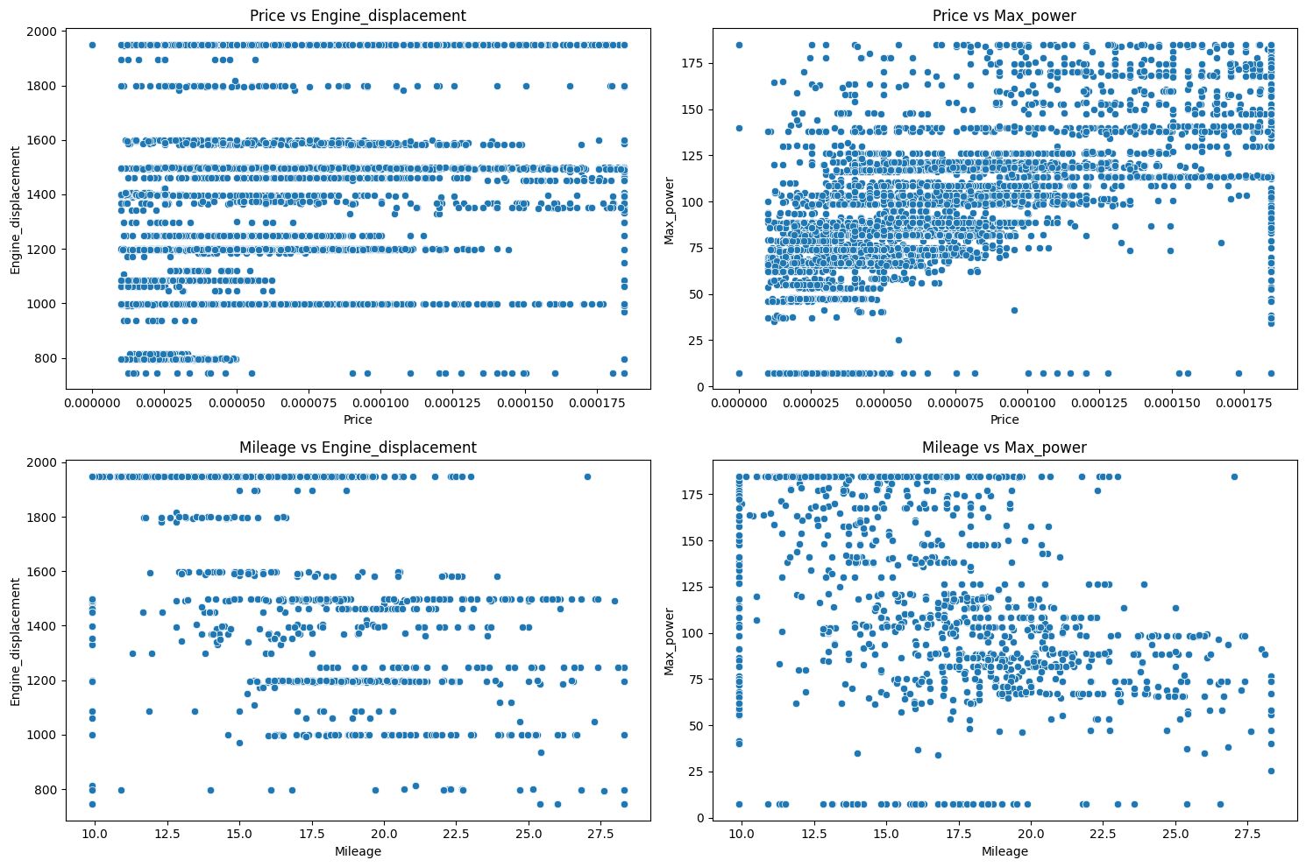
scatter plots
Summary: These scatter plots reveal expected relationships, such as higher engine displacement and max power correlating with higher prices and lower mileage. However, there is considerable spread in prices for similar engine displacements and power levels, suggesting that additional factors like brand, model, or condition may also impact price. The relationships between mileage, engine displacement, and power align with typical automotive trends, where smaller engines and lower power yield better fuel efficiency.

Slide 10
scatter plots our visualization
Price vs. Engine displacement: This scatter plot shows the relationship between the car's price and its engine displacement. It appears that there isn't a clear linear relationship, as the points are widely spread across the plot.
Price vs. Max power: This plot visualizes the relationship between the car's price and maximum power. Similar to the previous plot, there doesn't seem to be a straightforward trend, indicating that while max power might influence price, it is likely one of several factors.
Mileage vs. Engine displacement: This scatter plot compares mileage with engine displacement. Typically, as engine displacement increases, fuel efficiency (mileage) tends to decrease, but the relationship here seems varied, indicating other factors might also influence mileage.
Mileage vs. Max power: This plot displays the relationship between mileage and max power. A slight inverse trend might be visible, as higher max power cars generally have lower mileage, although the data points are somewhat scattered.

Slide 11
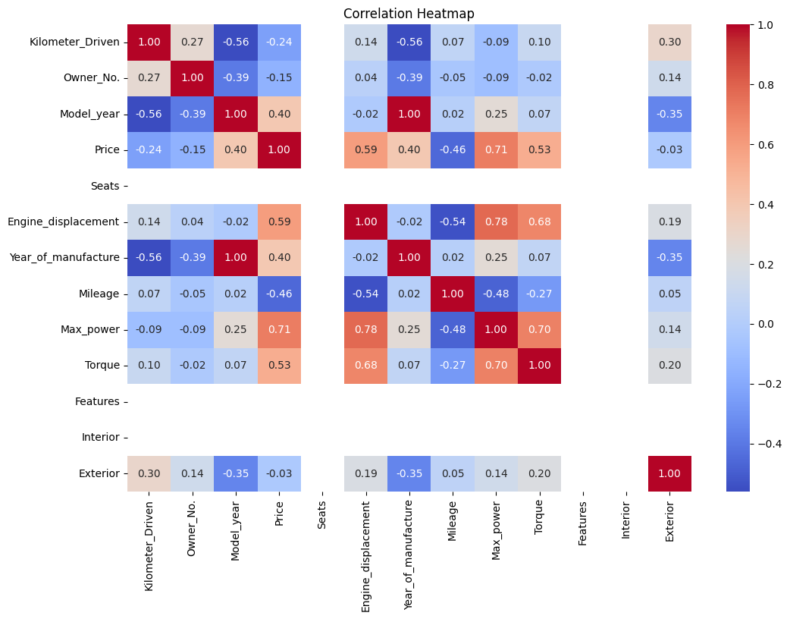
Heat map
Summary: The heat map highlights strong relationships, such as Price with Max power and Engine displacement, as well as Mileage’s inverse relationship with these features. The dataset exhibits logical trends typical in car markets, where newer, more powerful cars with larger engines tend to be more expensive, while fuel-efficient cars are generally smaller and less powerful. These insights can be valuable for predictive modeling, especially for price prediction or understanding factors that affect fuel efficiency.

Slide 12
correlation heatmap
Price Correlations:
Max power (0.71) and Engine displacement (0.59) show a strong positive correlation with Price, indicating that cars with higher power and larger engines tend to have higher prices.
Torque (0.53) also shows a moderate positive correlation with Price, which makes sense, as cars with higher torque are typically more expensive.
Model year (0.40) and Year of manufacture (0.40) have moderate positive correlations with Price, indicating that newer cars generally have higher prices.
Mileage (-0.46) has a negative correlation with Price, suggesting that cars with higher fuel efficiency are generally less expensive, possibly due to smaller or less powerful engines.
Mileage Correlations:
Engine displacement (-0.54) and Max power (-0.48) have moderate negative correlations with Mileage, reflecting that cars with larger engines and higher power usually have lower fuel efficiency.
Price (-0.46) shows a negative correlation with Mileage, which aligns with the idea that more fuel-efficient cars are typically less powerful and lower priced.

Slide 13
correlation heatmap
Year of manufacture and Model year:
These two features have a perfect positive correlation of 1.00, which likely indicates they are measuring the same or closely related aspects of the car (e.g., the year the car was manufactured and the model year).
Max power and Engine displacement:
These features have a strong positive correlation of 0.78, suggesting that cars with larger engine displacement tend to have higher power, as expected.
Other Observations:
Owner No. has a slight positive correlation with Kilometer Driven (0.27), which may indicate that cars with multiple owners tend to have higher mileage.
Exterior has a slight positive correlation with Kilometer Driven (0.30), which could indicate that cars with more use may show different exterior wear ratings or features.

Slide 14
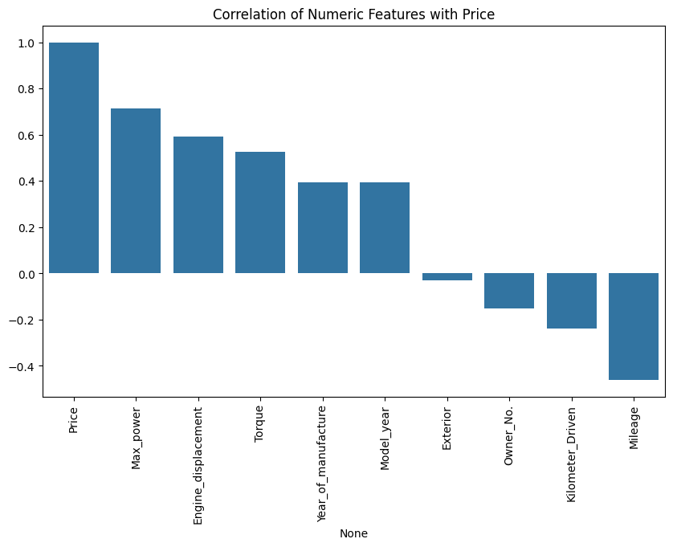
bar chart
Features with High Correlation with Price:
Price: 1.00 (Self-correlation)
Max Power: 0.71
Engine Displacement: 0.59
Torque: 0.53
Year of Manufacture and Model Year: 0.40
Features with Low/Negative Correlation with Price:
Exterior: -0.03
Owner Number: -0.15
Kilometer Driven: -0.24
Mileage: -0.46

Slide 15
Correlation with Price
Interpretation:
Max Power, Engine Displacement, and Torque have a strong positive correlation with Price, indicating that higher values for these features generally lead to higher car prices.
Mileage shows a moderate negative correlation with Price, suggesting that higher mileage tends to lower the car's value.
Kilometer Driven and Owner Number also show a negative correlation, though less strongly, indicating that cars with higher kilometers driven or more previous owners may have lower prices.

